Slide 1
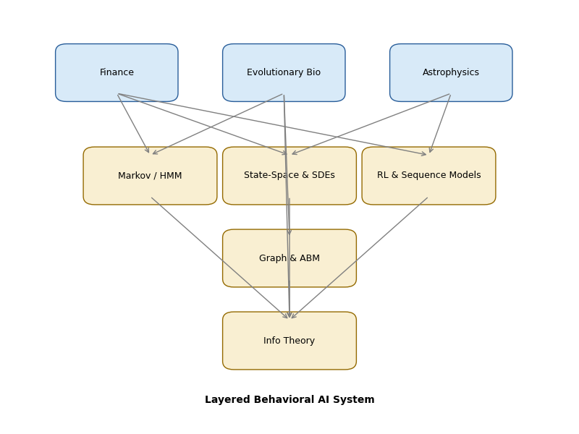
Cross‑Domain Modeling
for Behavioral AI
Finance, Evolutionary Biology & Astrophysics
Aug 30, 2025

Slide 2
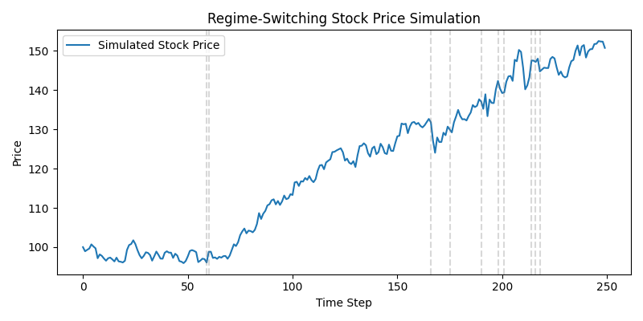
Why Cross‑Domain?
Transferable mathematical frameworks across finance, biology & astrophysics
Shared challenges: high‑dimensional, noisy & non‑linear systems
Evidence of cross‑application: HMMs map genomes & detect gravitational waves
Regime‑Switching Simulation
[1] [2] [3]

Slide 3
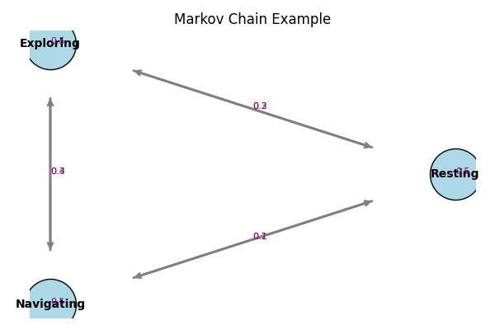
Hidden Markov Models & Regime Switching
Finance: HMM reveals bullish/calm/bearish regimes & persistence
Evolution: HMM profiles map Complex I subunits across 11k species
Astrophysics: HMM‑Viterbi tracks stochastic frequency wander
Behavioural AI: infer latent mental states & transitions
Markov Chain Diagram
[4] [5] [6] [7]

Slide 4
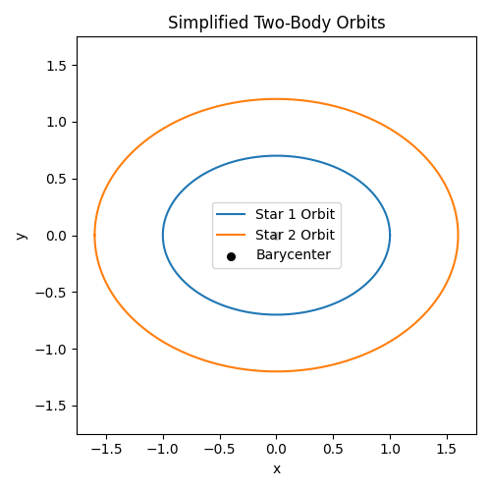
State‑Space Models, SDEs & Reinforcement Learning
State‑space & Kalman filters: estimate hidden states & handle process noise
Stochastic differential equations: continuous‑time dynamics & random shocks
Reinforcement learning: adaptive decision‑making; actor–critic reduces trading losses
Astrophysics RL: optimize telescope scheduling
Orbit & Kalman Filter Illustration
[8] [9] [10] [11]

Slide 5
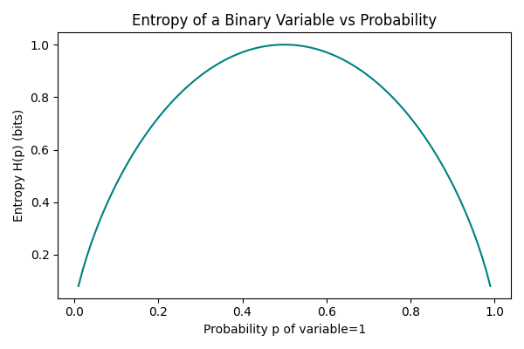
Graph & Agent‑Based Models / Information Theory
GNNs capture relationships across finance, biological networks & celestial bodies
Agent‑based models simulate heterogeneous agents & emergent behaviour
Information theory quantifies uncertainty & mutual information; used to decompose sensorimotor, contextual & episodic components
Entropy Demonstration
Domain | Model | Key contribution
Finance | ABMs, GNNs | Market crashes & herding
Biology | ABMs, GNNs | Evolutionary dynamics & social networks
Astrophysics | Graphs | Sensor networks & celestial interactions
[12]

Slide 6
Layered System & Future Directions
Domain knowledge inspires model choice
Model layer: HMMs, state‑space, RL, GNNs & ABMs work together
Information‑theoretic metrics guide uncertainty & tipping‑point detection
Psychological tipping points can be predicted using cross‑domain insights
Integrating cross‑domain models unlocks new frontiers for behavioural prediction and personalised mental‑health interventions.
[13] [14]

