Slide 1
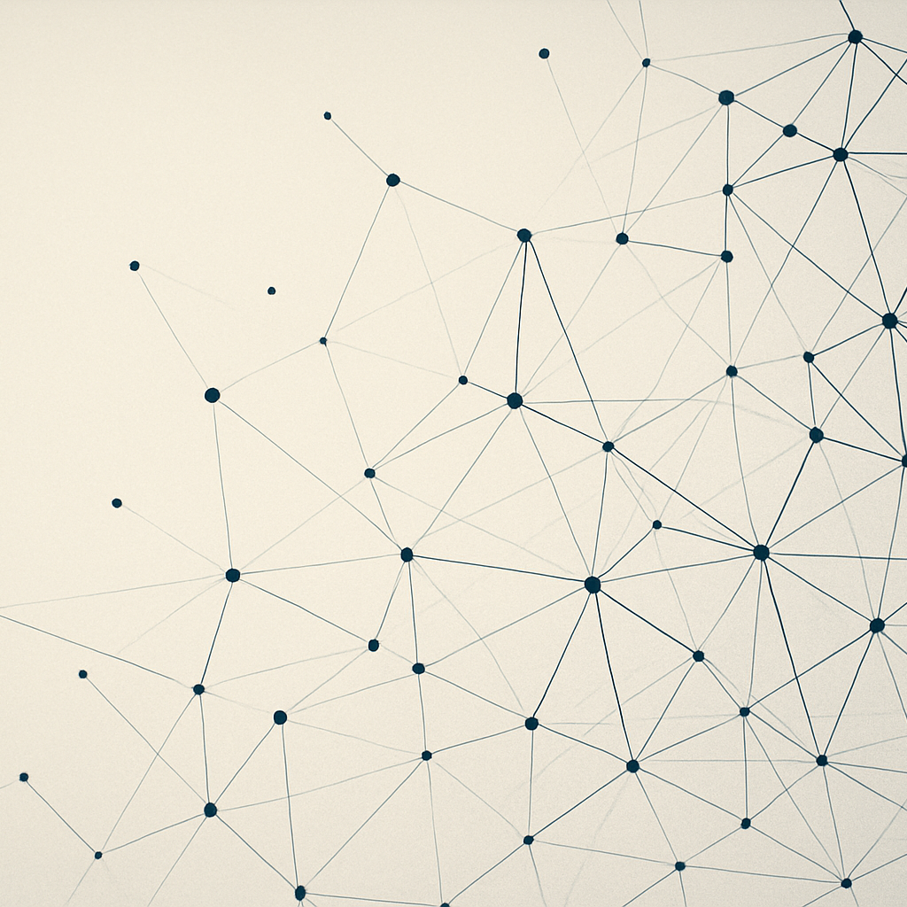
Behavioral Modeling & AI
From Markov Chains to Transformers
Aug 30, 2025

Slide 2
Agenda
Markov & Hidden Models
Bayesian & State‑Space
Stochastic Dynamics & Chaos
Reinforcement & Sequence
Graph & Agent‑Based
Information & Integration

Slide 3
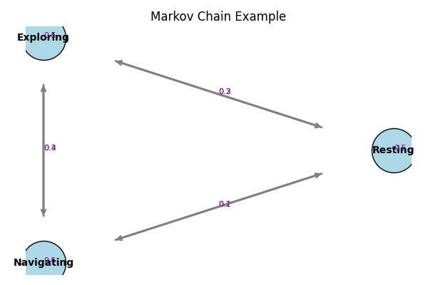
Markov Chains & Hidden Markov Models
Simple memoryless transitions between discrete states
Model sequential behavioural patterns (e.g. rest → explore → navigate)
Hidden Markov Models infer unobserved mental states from observable behaviour
[1]

Slide 4
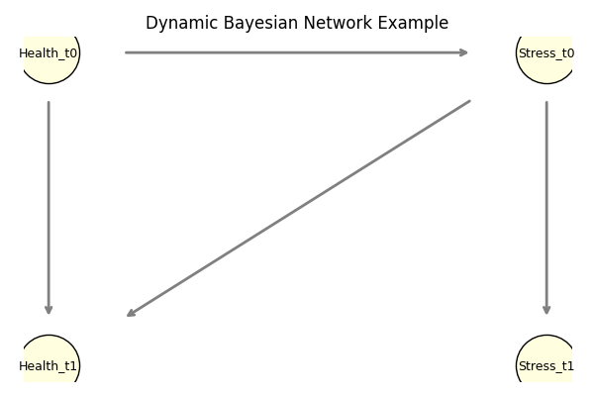
Bayesian & State‑Space Models
Bayesian networks encode causal dependencies and incorporate prior knowledge
Dynamic BNs extend this structure across time to capture inter‑temporal relations
State‑space models & Kalman filters estimate latent trajectories from noisy observations
Applied to mental‑health forecasting and real‑time physiological monitoring
[2] [3]

Slide 5
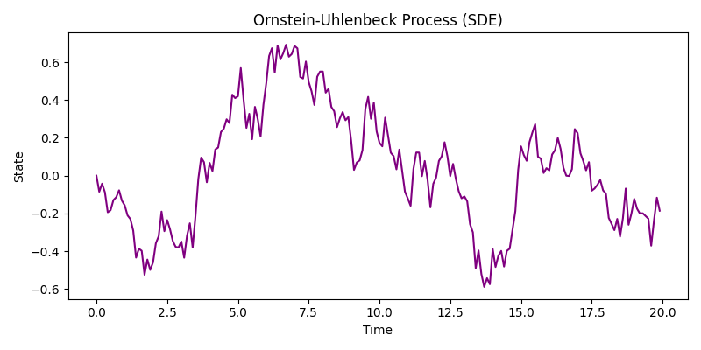
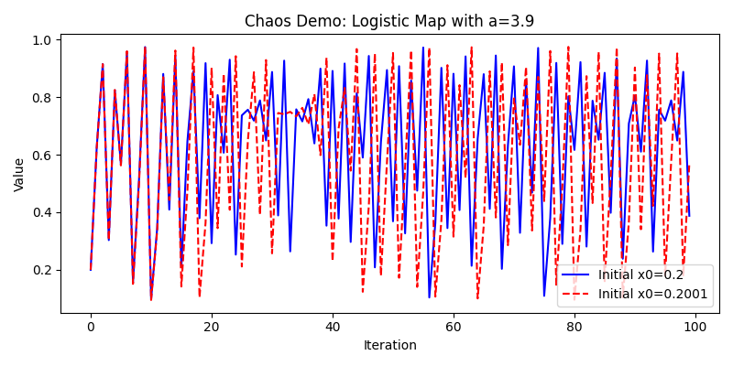
Stochastic Dynamics & Chaos
Stochastic differential equations (SDEs) capture continuous‑time dynamics with drift & noise
Allow modelling of attractor points, reactivity to inputs and strength of return
Chaos theory: behaviour change can be quantum, sensitive to initial conditions & emergent
[4] [5]

Slide 6
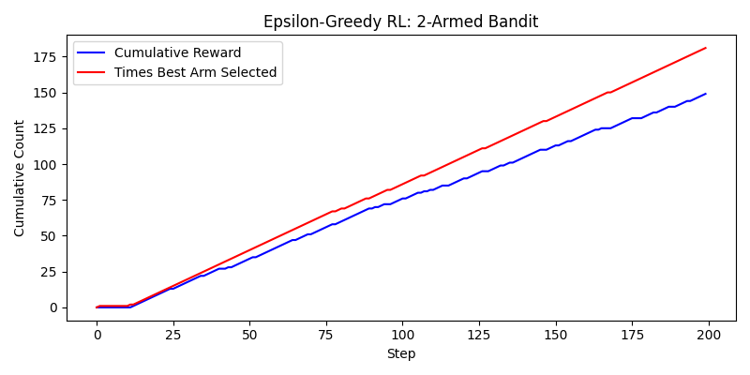
Reinforcement Learning & Sequence Models
Reinforcement learning (RL) learns policies from behavioural feedback to personalise interventions
Dynamic treatment regimes adapt to sensor data & prevent relapse in mental health
Sequence models (RNN, LSTM, Transformer) capture long‑range dependencies & multimodal signals
Combining RL with transformers enables personalised prediction and targeted intervention
[6] [7] [8] [9]

Slide 7
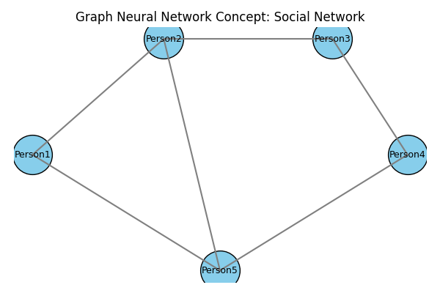
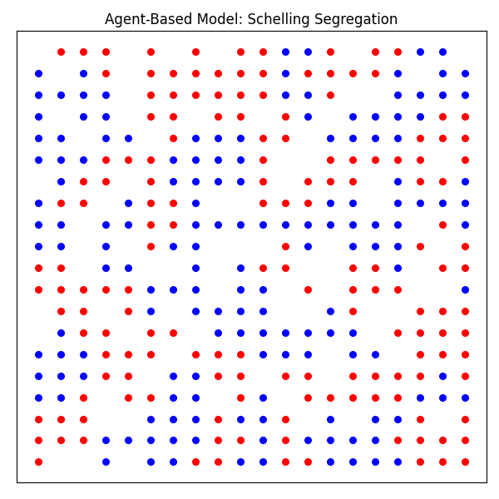
Graph Neural & Agent‑Based Models
Graph neural networks learn structural patterns from multimodal connectivity data
Used to detect depression and predict antidepressant response across brain networks
Agent‑based models simulate interactions of heterogeneous individuals & emergent behaviour
[10] [11] [12]

Slide 8
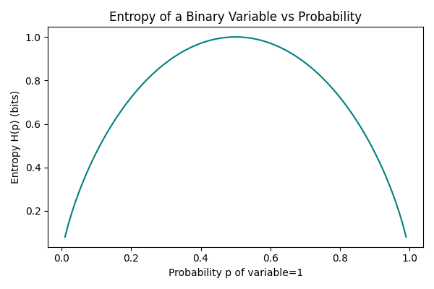
Information Theory & Integrated Framework
Information theory quantifies uncertainty, entropy and mutual information
Cognitive control network activation scales with task entropy and decomposes into sensorimotor, contextual & episodic components
Integrated architecture: perception via sequence & chaos detection; causal inference via Bayesian & state‑space; network layer via GNN & ABM; control via RL
[13] [14]

Slide 9

Conclusion & Future Directions
Diverse modelling approaches complement each other: simple Markov transitions, causal Bayesian structures, continuous stochastic dynamics, adaptive RL & sequence models, network‑level GNN/ABM and information theoretic measures
Integration across layers yields robust, interpretable AI for mental‑health & behavioural interventions
Future work: multimodal, cross‑scale models, ethical considerations and real‑time personalisation

